Slide 1
Shared Community Health Needs Assessment (CHNA)
Creating The Story About Our Data
Kennebec County
Fall 2015/Spring 2016
Notes:
Welcome/Introductions
Recognition of sponsors, organizations providing space/refreshments/other resources
Some brief housekeeping details….bathrooms, cell phones, agenda
We are here as part of the mission of the Maine Shared Health Needs Assessment & Planning Process Project, also called Maine SHNAPP. Our mission is to create the framework and approach for a shared CHNA that [a] provides valuable population health assessment data to interested organizations and individuals, [b] supports public health accreditation efforts, and [c] addresses community benefit reporting needs of hospitals.
Ultimately, the Maine SHNAPP seeks to turn data into action and create the healthiest population in the USA.

Slide 2





Maine SHNAPP Funders
Notes:
This project is supported financially and with resources by the four largest hospital systems in Maine and the Maine CDC.
Brief history -- EMHS, MG, and MH worked together in 2010-11 to create the OneMaine Health Collaborative CHNA and the Maine CDC completed the 2012 SHA.
Statewide Coordinating Council for Public Health facilitated the conversation among Maine CDC/DHHS and hospital leaders to work together on a unified health needs assessment and community engagement process – resulting in the Maine SHNAPP & Shared CHNA.
This is the 1st state-wide public private partnership of its kind in the nation.

Slide 3
4 Phases of the SHNAPP Process
Data Collection & Analysis
Needs Assessment Reporting
Community Engagement
Health Improvement Plans
Notes:
Phase I: Data collection and analysis. The quantitative data come 25 sources (surveillance surveys such as BRFSS, MIYHS; patient visits to the emergency room or hospitalizations from MHDO; and disease registries such as the Cancer Registry). There are over 160 indicators within 18 domains or health categories. The epidemiologists from the Maine CDC and analysts from Market Decisions collaborated to analyze these data. In addition Market Decisions conducted a Stakeholders Survey in May/June 2015. There were over 1,600 responses from every county. Stakeholders rated their experiences of top health issues and factors affecting where we live, work, learn, and play that can impact our health.
Phase II: Needs Assessment Reporting. Data were analyzed at the state and county-levels (and among 3 urban areas) for reporting. The next slide will outline these details.
Phase III: Community Engagement. Taking the reports to community members representing organizations and individuals with an interest in improving the health is the objective of CE. As we are doing today, groups or individuals will be discussing Shared CHNA Reports, identifying health needs, prioritizing health needs, naming assets, resources, gaps in local ability to address health needs, and sharing perceptions about the factors that affect health.
Phase IV: Health Improvement Plans. Shared CHNA Reports and CE input are reviewed collectively in order to create the State Health Improvement Plan (SHIP), District Public Health Improvement Plans (DPHIP), and hospital Implementation Strategies (IS).

Slide 4
Data Included in the Shared CHNA Reports
Notes:
This slide provides the opportunity to go into more detail about Phases I-II.
Reports included in Shared CHNA
State-level Report (1)
County-level Reports (16)
Summary Reports
County-level (16)
Public Health District (5 that have more than 1 county)
Urban area for Bangor, Lewiston/Auburn, Portland

Slide 5

Setting the Stage for Our Story
Shared CHNA data tell a story
Data interpretation
Your role in the story
Pulling it all together
Notes:
We are here today to create the story about our data. This is how we begin to turn data into action. Set the stage….
“Shared CHNA data tell a story”
Data is more useful and interesting when it relates to our lives and our community.
Likewise, our lives and community have an impact on future data.
We live in communities and relate to local events. Our health is local and it helps to use local data. Local = County
“Data interpretation”
The data we are reviewing come from different places; some from an online Stakeholders Survey (May-June 2015 among about 1,600 people in Maine from over 80 organizations and businesses), some from 25 sources including surveys, health data (in-patient and office visits), and disease registries.
Shortly we’ll review some basic details to make sure we are using the same script.
All data have limitations –
Survey data is self-reported. What someone chooses to share or remembers may be different than actual experience.
Data come from multiple sources. They way numbers are collected may have used different methods.
Data come from different years. We used the most current year that data was available but it differs among sources.
“Your role in the story”
Data don’t tell the entire story.
Each of you play an important role in that you experience life here and have valuable insights into the health concerns of your neighbors, co-workers, family members, etc. There are things that affect where we live, play, learn, and work that affect our health, and you know about these too.
After we spend a little time looking over the “numbers” (data), we’ll separate into smaller groups to discuss our perceptions, thoughts, and experiences related to the health of people here.
“Pulling it all together”
The story about our data comes from discussing the Shared CHNA, getting input from experts and community members alike, and using all of this information to develop health improvement plans.
Health improvement plans – called implementation strategies by hospitals – are documents that guide the focused actions of organizations. They are similar to strategic plans for businesses or lesson plans for teachers.

Slide 6


The Script
Notes:
Provide or reference the HANDOUT of the County/District Summary Data Sheet
Previous mention of data ≠ whole story; We are using the data as a script from that we interpret based on our experiences living, working, learning, and playing in this county/district
We know things about our families, neighbors, co-workers, students, customers, and patients that provide important context for the data
This is what we are here to share today

Slide 7
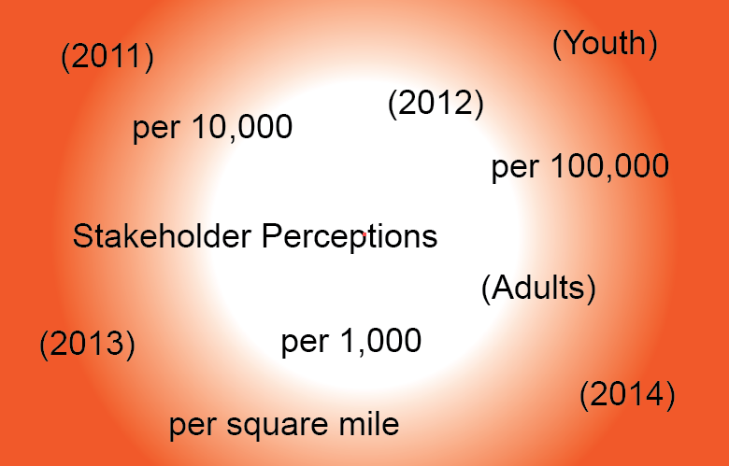
Interpretation – Things to Consider
Notes:
Important – The numbers that make up data in this report are not “equal” and this needs to be considered during our discussion.
It is not possible to learn about every member of a population so we SAMPLE to learn about health issues and behaviors. We estimate population numbers too.

Slide 8
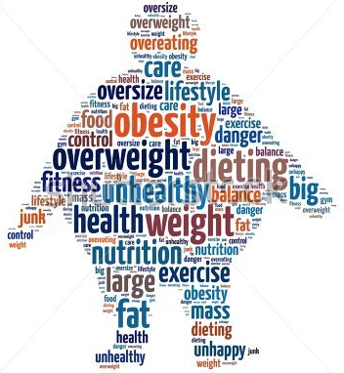

Interpretation – Things to Consider
Obesity
100 people
Notes:
First, consider obesity. It is reported as a percentage. In the USA, 30% of adults are obese – if we gathered 100 adults randomly, we would expect 30 of them to be obese.
30% of adults in the USA have obesity. There are 30 orange people and 100 people total.
Stated another way, about 1/3 of adults are obese.
If needed photo credit for word art: www.shutterstock.com 107256155

Slide 9


Interpretation – Things to Consider
Infant Death
1,000 infants
Notes:
Second, consider infant death. It is reported as a number of deaths per 1,000 births.
In the USA, Maine, and Kennebec County that number is 6 infant deaths per 1,000 births.
This number is much lower than the number of people who are obese but is serious because it results in death. There is also a “ripple effect” – the family who lost the baby is affected by this death in different ways.
6 of every 1,000 babies born do not survive.
There are 6 red infants and 1,000 infants total.
If we randomly gathered 1,000 birth certificates, we would expect 6 of them to be for infants that did not survive.

Slide 10


Interpretation – Things to Consider
Deaths due to Diabetes
100,000 people
Notes:
Third, consider deaths due to diabetes. It is reported as a number of deaths per 100,000 population. In Maine, that is 20 deaths per 100,000 – if we randomly gathered 100,000 people from all over Maine, we would expect 20 of them to die from diabetes this year.
There are 100,000 small people within the square on the screen and 20 of them are red.
20 out of 100,000 people die from diabetes each year in Maine.
This is much lower than the number of people who have obesity or the number of infants who die but still considered a serious issue because it results in death. There is a “ripple effect” for the family and friends of the person who dies from diabetes.
We can agree all three of these issues are serious public health concerns that deserve attention and intervention. This is a demonstration that we cannot base our decisions on the size of numbers alone. We need to look at numbers within context.
You also see on your Summary Report (bottom of page) mention of statistical significance. This means the difference in the numbers (for example, between Kennebec County and Maine) did not happen by chance. When we read the results are statistically significant at the 95% confidence interval, we are 95% confident we would get the same results from a different sample.

Slide 11
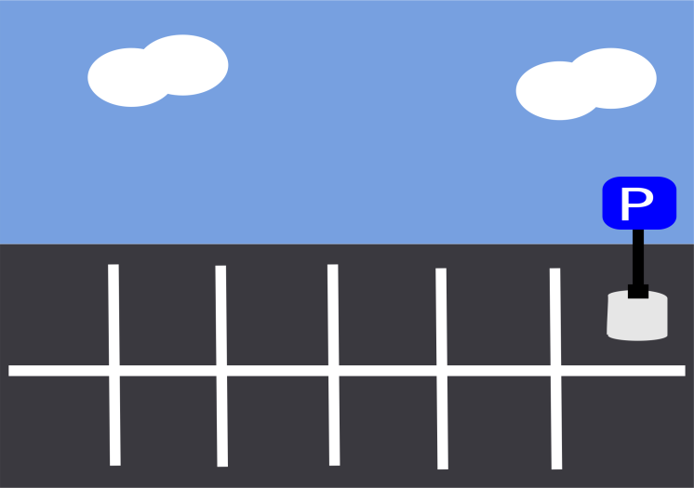
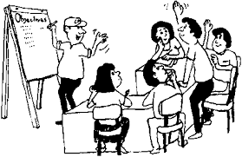


Our Task Today….
Notes:
We’ll be referring to our data summary sheets and stakeholder survey findings while we look at slides of certain health topics that affect most of us – either personally or someone we love, or through the work we do.
We’ll be looking at topics that affect a large number of us or that have significant differences between our area and the state as a whole.
We will take 2-minute breaks after each brief topic review to look over our Summary Reports.
This is a time to review quietly – and make notes about questions you have for further discussion after the data presentation.
Since we cannot look over all topics, we have set up a parking lot/bike rack, depending on your mode of transportation ☺
It is located –[show where the lot/rack is] .
Anyone is invited to write down topics they feel are important health topics, or issues that affect where we live, work, learn, and play that can impact health.
We’ll review these at the end of our time together ensure we all have an awareness about them.
We’ll talk about how we can continue addressing these important issues.
If this Community Forum plans breakout sessions, mention
While we are reviewing the information in upcoming slides, consider which breakout session(s) you would like to join.
Explain [#] round(s) of breakout discussions before coming back together as a group to wrap our time together. [Or plan next steps]
Explain different breakout session topics and if there is a visual whether on the agenda or signs/easels around, point this out.
In these breakout sessions, we’ll answer some questions as a group and record our input.
If this Community Forum plans a Panel Discussion, mention
Expectations for panel and opportunity for group members to ask questions identified during 2-minute data breaks

Slide 12
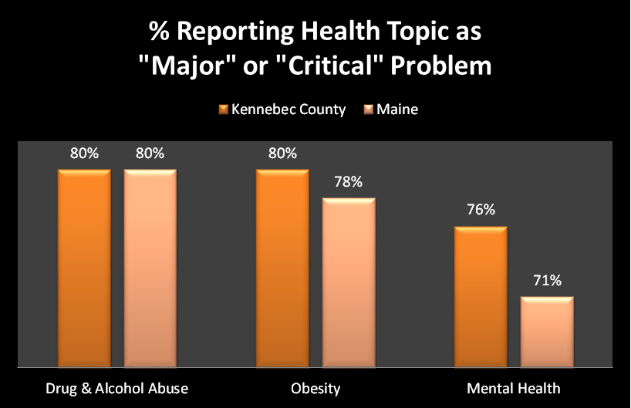
Top health issues for Kennebec County
Stakeholder Survey – Total 1,639 surveys; Kennebec County 220 surveys
Source: Maine SHNAPP Stakeholder Survey, 2015
Notes:
These are the top 3 health issues for Kennebec County based on information provided by the 220 respondents from this county on the Stakeholders Survey.
People who responded to the survey were asked to rank health issues on a scale of 1-5 where “1” was Not at all a problem and “5” was Critical problem. (“4” = Major problem).
The full report for the county identifies the top 5 health issues [reports are located at www.maine.gov/SHNAPP/].
Note Drug & Alcohol Abuse and Obesity are tied for the #1 health issue in Kennebec County.
The top 3 health issues for the state were:
Drug & Alcohol Abuse – 80%
Obesity – 78%
Mental Health – 71%

Slide 13
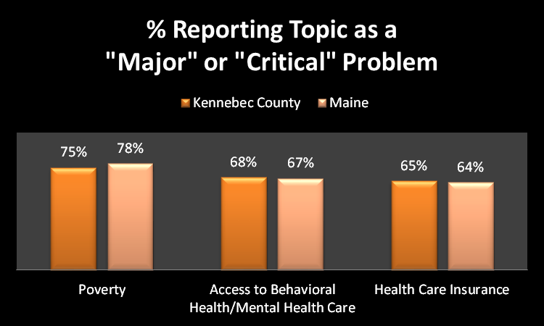
Top issues affecting where we live, work, learn & play in Kennebec County
Stakeholder Survey – Total 1,639 surveys; Kennebec County 220 surveys
Source: Maine SHNAPP Stakeholder Survey, 2015
Notes:
These are the top 3 issues affecting where we live, work, learn, and play in Kennebec County based on information provided by the 220 respondents from this county on the Stakeholders Survey.
People who responded to the survey were asked to rank these issues on a scale of 1-5 where “1” was Not at all a problem and “5” was Critical problem. (“4” = Major problem).
The full report for the county identifies the top 5 issues [reports are located at www.maine.gov/SHNAPP/].
The top 3 issues for Maine were identified as:
Poverty – 78%
Access to Behavioral Care/Mental Health Care – 67%
Transportation – 67%

Slide 14
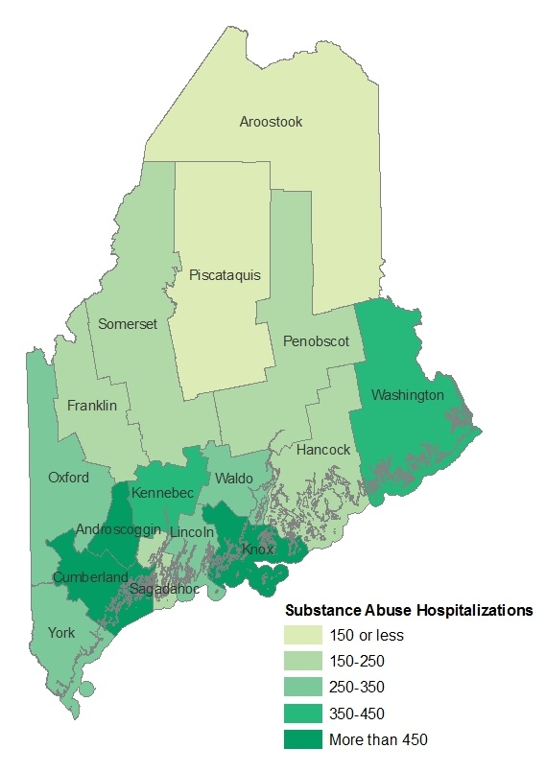
Drug & Alcohol Abuse
Kennebec County
Substance Abuse Hospitalizations by County
Kennebec
351 per 100,000
Maine
328 per 100,000
Per 100,000 population
Maine Shared Health Needs Assessment, 2015
Source: Maine Health Data Organization, 2011
Notes:
Now we will briefly take a look at the top 3 health issues. Let’s begin with Drug & Alcohol Abuse.
This map shows how all counties in Maine compare to each other on the # of hospital admissions for substance abuse.
Kennebec County is higher than Maine at 351 vs 328 per 100,000 population; This is not measured at the national level.
Androscoggin, Cumberland, and Knox Counties have higher rates of SA hospital admissions than Kennebec.
Data is from 2011.

Slide 15
Drug & Alcohol Abuse
Kennebec County
Source: Maine Emergency Medical Services, 2014
Notes:
Another way we can explain the issue with drug & alcohol abuse is to look at the number of calls to 911 (EMS) for drug overdose per 100,000 population.
Kennebec County is higher than Maine at 416 vs 391 per 100,000 population; This is not measured at the national level.
These data are from 2014.

Slide 16
Drug & Alcohol Abuse
Kennebec County
Source: Maine Integrated Youth Health Survey, 2013
Notes:
We are also interested in what high school students report for substance use.
Shown are % of students in grades 9-12 self-report of past 30 day use of alcohol, marijuana, and non-medical Rx drugs.
In Kennebec County, a smaller percentage of HS students reported drinking alcohol, using marijuana, or taking Rx drugs in the past 30 days than the state percentage.
Another way to think of these numbers is to think of 24 of every 100 students using alcohol in the past 30 days or 20 of every 100 using marijuana in the past 30 days…..
These data are from 2013.

Slide 17

2 Minute Data Review
Notes:
Please take 2 minutes to look over your handout: Summary Data for Kennebec County.
The Substance Abuse section is on page 2 (short version), page 4 (longer version), and page 5 Central District Summary.
This topic will be discussed further [as a breakout session or as part of the panel discussion] – if you have any questions, please write them down to discuss at that time.
If you have questions about another topic and it does not appear as a topic for breakout [or panel discussion] or relates to data in general, please write it on the Parking Lot.
Presenter [or someone identified as timekeeper] should watch time.

Slide 18
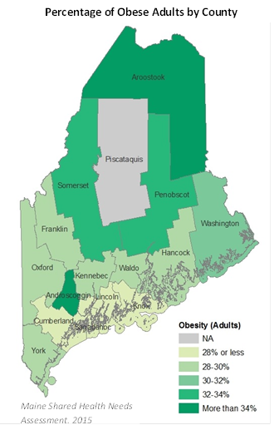
Obesity
Kennebec County
Percentage of Obese Adults by County
Kennebec
28%
Maine
29%
Source: Behavioral Risk Factor Surveillance System (BRFSS), 2013
Notes:
This map shows how all counties in Maine compare to each other on the % of obese adults. While the difference between the county and the state is not a lot, recall the graphic showing 1/3 of all people with obesity is a high percentage overall.
The data were not included for Piscataquis because the numbers of people answering this question were too low. Because of this issue with small numbers we’re working to expand the sample size in 2016.
Kennebec County is about the same as Maine (and nationally @ 30%).
The darker green shows higher percentages of obesity among adults.
These data are from 2013.
Obesity defined via BRFSS U.S. Core – people self-report their height and weight which is used to calculate BMI those above 30 are considered obese.

Slide 19
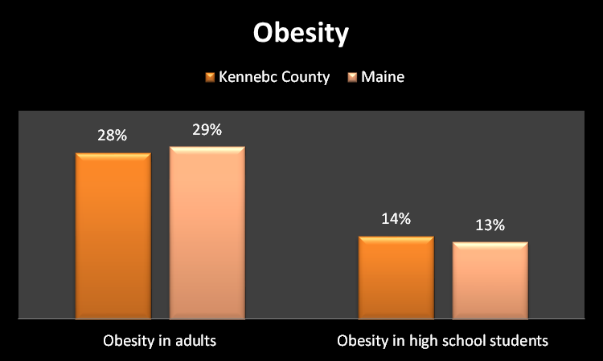
Obesity
Kennebec County
Source for adults: Behavioral Risk Factor Surveillance System (BRFSS), 2013
Source for high school students: Maine Integrated Youth Health Survey (MIYHS), 2013
Notes:
The bars on the left show the same information that we just saw in the map on the previous slide.
On the right, we can see among high school students in grades 9-12 that obesity is slightly higher than the state percentage.
Stated differently, if we randomly selected 100 students in 9-12 grade in Kennebec County, 14 of them would have obesity; If we randomly selected 100 students across the state, 13 of them would have obesity.
These data are from 2013.

Slide 20
2 Minute Data Review
Notes:
Please take 2 minutes to look over your handout: Summary Data for Kennebec County.
The Physical Activity, Nutrition, & Weight section is on page 2 (short version), page 3-4 (longer version), and page 4-5 Central District Summary.
This topic will be discussed further [as a breakout session or as part of the panel discussion] – if you have any questions, please write them down to discuss at that time.
If you have questions about another topic and it does not appear as a topic for breakout [or panel discussion] or relates to data in general, please write it on the Parking Lot.
Presenter [or someone identified as timekeeper] should watch time.

Slide 21
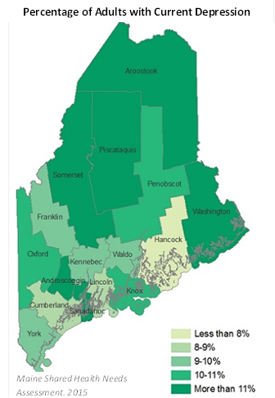
Mental Health & Depression
Kennebec County
Current Depression among Adults by County
Kennebec
10%
Maine
10%
Source: Behavioral Risk Factor Surveillance System (BRFSS), 2013
Notes:
Difference between mental health & depression – Shared CHNA views Mental Health as defined on your Summary Report list of measures:
Ever having anxiety or depression
Having current symptoms of depression
MH emergency department rates
Receiving MH treatment in the past 12 months
DEPRESSION was listed as a chronic condition within the Stakeholders Survey and was rated as a “top 5” health concern
This map shows how all counties in Maine compare to each other on the % of adults with current depression.
Kennebec County is the same as Maine. This is not measured at the national level.
The darker green shows higher percentages of current depression among adults. Piscataquis and Somerset Counties have the highest %s in Maine.

Slide 22
Mental Health & Depression
Kennebec County
Source: Behavioral Risk Factor Surveillance System (BRFSS), 2013
Notes:
While the last map showed percentage of current depression among adults…
This shows the percentage of adults who have ever had anxiety (21% in Kennebec County and 19% in Maine)
And the percentage of adults who have ever had depression (24% in Kennebec County and 24% in Maine)
These data are from 2013.

Slide 23
2 Minute Data Review
Notes:
Please take 2 minutes to look over your handout: Summary Data for Kennebec County.
The Mental Health section is on page 2 (short version), page 3 (longer version), and page4 Central District Summary.
This topic will be discussed further [as a breakout session or as part of the panel discussion] – if you have any questions, please write them down to discuss at that time.
If you have questions about another topic and it does not appear as a topic for breakout [or panel discussion] or relates to data in general, please write it on the Parking Lot.
Presenter [or someone identified as timekeeper] should watch time.

Slide 24
[Date] Community Forum
Panel Discussion
Name panelists here
Notes:
Remove this slide if your Community Forum is not holding a Panel Discussion
Add details if you are using this slide ☺
Considerations for Panel Discussion:
-Invite local experts on the topics you want to highlight during the forum
-Spend time with panelists before the event to set up expectations (outline questions that will be asked, facilitator’s role, timekeeping and signals for limiting time)
-Idea: Use items from Parking Lot to guide some responses from panelists

Slide 25

[Date] Community Forum
Session Topic | Location
Drug & Alcohol Abuse | Insert location
Obesity | Insert location
Mental Health | Insert location
Notes:
Remove this slide if your Community Forum is not holding Breakout Sessions
Edit this slide if you plan to discuss multiple topics as a group….
Add details if you are using this slide ☺

Slide 26

Shared CHNA Contacts
Maine CDC District Liaison SHNAPP Hospital Representative
Paula Thomson Joy McKenna
Phone Phone
Email Email
Additional SHNAPP Contacts Additional SHNAPP Contacts
Nicole Hammar Name
Phone Phone
Email Email
Shared CHNA Reports: www.maine.gov/SHNAPP/
Notes:
Add local contacts
Recommendation – print this slide as a Handout for participants

